Slide 1
Contemporary Moral Problems
M-F12:00-1:00SAV 264
Instructor: Benjamin Hole
Email: bvhole@uw.edu
Office Hours: everyday after class

Slide 2

Agenda
Clicker Quiz
Finish/discuss Dworkin
Begin Hill

Slide 3
Ronald Dworkin’s view on pornography and censorship is best described as:
conservative
liberal
moralist
feminist
game theoretic
none of the above

Slide 4
Hill’s article is best seen as an application of what ethical theory?
consequentialism
utilitarianism
virtue ethics
Kantian ethics
natural law theory
none of the above

Slide 5
Which of the following is not a central claim in Hill’s argument against pornography?
Some pornography causes violence and/or discrimination against women
The pornography industry lies about the nature of women for its own financial gain
Some pornography presents women as having less moral value than persons
One need not rely on empirical studies about the effects of pornography to show that it is often morally objectionable
None of the above

Slide 6
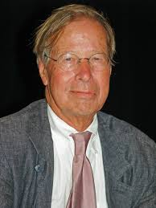
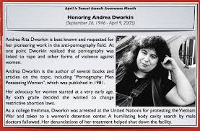
Ronald Dworkin, “Liberty and Pornography”

Slide 7
Ronald Dworkin, “Liberty and Pornography”
Discussion of Isaiah Berlin's “Two Concepts of Liberty”
Two kinds of liberty:
Negative liberty: liberty to not be obstructed by others in doing what one wishes to do
Positive liberty: power to control or participate in public decisions
The complexity of political value
The “Platonic ideal”: all the political virtues can be realized in a single political structure
Platonic ideal “a seductive myth”; some freedoms conflict with others

Slide 8
Dworkin: Two Kinds of Liberty
Mill’s Harm Principle: In the absence of some direct harm to a non-consenting other person, there is no justification for coercion.
Freedom of speech is a negative right.
Most speech, including most forms of pornography, does not directly harm a non-consenting other person.
Given a liberal perspective, such as the harm principle, negative rights trump positive rights.

Slide 9
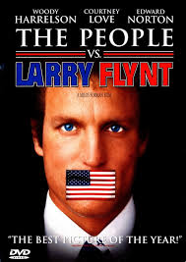
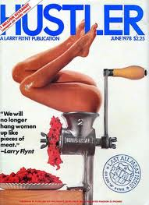
“The People vs. Larry Flynt,” Movie CLIP - The Supreme Court (1996)
https://www.youtube.com/watch?v=MeTuNES82O0

Slide 10
In the absence of some direct harm to a non-consenting person, there is no justification for censoring expression of free speech, such as pornography.
Strongly Agree
Agree
Somewhat Agree
Neutral
Somewhat Disagree
Disagree
Strongly Disagree

Slide 11
Liberty and Pornography
One argument against pornography
Dworkin's objection
It conflicts with equality and women's positive liberty.
This is a causal argument, and as such is “strikingly implausible.” Moreover, the negative causal influence of television and other aspects of popular culture is probably much greater than that of pornography.

Slide 12
Pornography conflicts with equality and women's positive liberty.
Strongly Agree
Agree
Somewhat Agree
Neutral
Somewhat Disagree
Disagree
Strongly Disagree

Slide 13
Liberty and Pornography
Another argument against pornography
Dworkin's objection
Frank Michelman
Pornography SILENCES women.
Although it is possible that pornography could violate a positive right, it does not deprive others of their negative liberty to speak.

Slide 14
Liberty and Pornography
The pro-censorship feminist arguments in question can be understood as appealing to women’s positive liberty to participate equally with men in community.
The idea, then, is that the positive liberty in question ought to limit the negative liberty of free speech and expression when it comes to pornography.
Dworkin instead argues that even if pornography interferes with women’s positive liberty to participate in political processes, this would not justify censoring pornography.

Slide 15
Even if pornography interferes with women’s positive liberty to participate in political processes, this would not justify censoring pornography.
Strongly Agree
Agree
Somewhat Agree
Neutral
Somewhat Disagree
Disagree
Strongly Disagree

Slide 16
“Pornography and Degradation”
Judith M. Hill

Slide 17
“Pornography and Degradation”
Victim Pornography
“the graphic depiction of situations in which women are degraded by sexual activity”
Kantian Sexual Ethics
Kant: “Act so that you treat humanity, whether in your own person or in that of another, always as an end and never as a means only.”
Mappes: “It is morally wrong for A to use B merely as a means to achieve A's ends.”

Slide 18
“Pornography and Degradation”
Victim Pornography
“the graphic depiction of situations in which women are degraded by sexual activity”
Hill
“A person is degraded when she is publicly, or at least overtly, treated as a means only, as something less than a person. Degradation involves de-grading at least in the sense that it entails a (false) imputation of a lower moral status than persons.”

Slide 19
“Pornography and Degradation”
Victim Pornography
“the graphic depiction of situations in which women are degraded by sexual activity”
Hill
Note that Hill is not focusing on any harms caused by victim pornography.

Slide 20
“Pornography and Degradation”
Classic Problems for Kant
Rigorism
Vacuity (Sneaky Maxim Maker)
Covert Consequentialism
Moral Standing
Autonomy
Kantian Sexual Ethics
Kant: “Act so that you treat humanity, whether in your own person or in that of another, always as an end and never as a means only.”
Hill: “A person is degraded when she is publicly, or at least overtly, treated as a means only, as something less than a person. Degradation involves de-grading at least in the sense that it entails a (false) imputation of a lower moral status than persons.”

Slide 21
A Kantian approach to pornography
Strongly Agree
Agree
Somewhat Agree
Neutral
Somewhat Disagree
Disagree
Strongly Disagree

Slide 22
“Pornography and Degradation”
A moral implication:
Given that it is wrong to treat persons merely as means, and given that victim pornography depicts women as mere means (as “less than persons”), it follows that victim pornography is morally objectionable.
A legal implication:
Because victim pornography depicts women as less than persons, the pornography industry is guilty of libel
a false statement that is damaging to a person's reputation.

Slide 23
Moral Implication
Strongly Agree
Agree
Somewhat Agree
Neutral
Somewhat Disagree
Disagree
Strongly Disagree

Slide 24
Legal Implication
Strongly Agree
Agree
Somewhat Agree
Neutral
Somewhat Disagree
Disagree
Strongly Disagree

